Slide 1

A proper nutrition-rich diet is vital for a healthy and active life

Slide 2
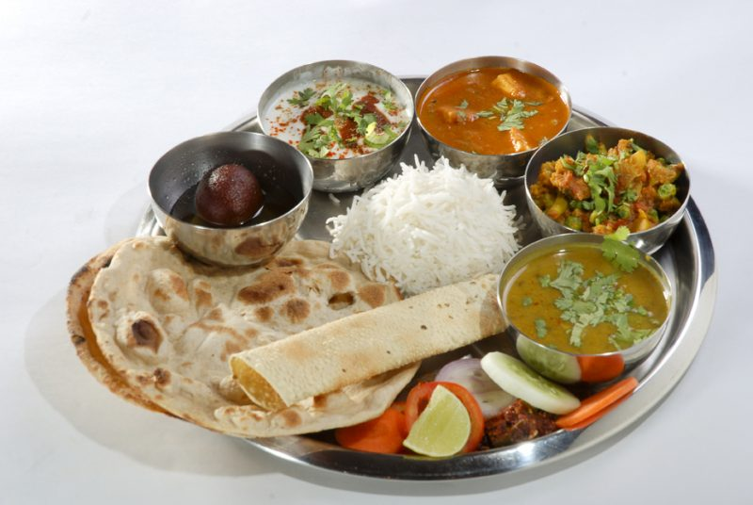
Is your meal fulfilling your daily nutritional requirements?

Slide 3
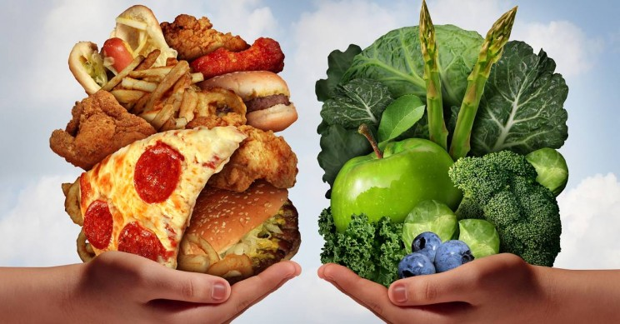
We may miss essential nutrients due to
Lack of essential nutrients in our meal
Poor diet
Poor absorption
Not only this….. there are more reasons

Slide 4



Stress
Sedentary lifestyle
Skipping meals

Slide 5


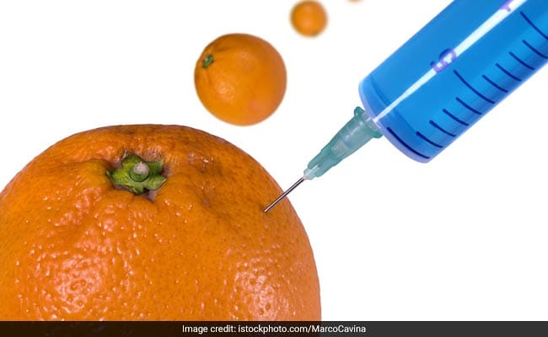
Junk food
Impaired Food Habits
Adulterated food

Slide 6

All these reasons lead to nutritional deficiency and
ultimately an
Inactive life

Slide 7



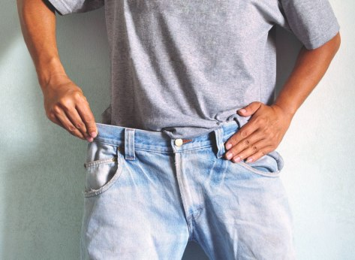


Impacts of an inactive life
Weakness
Obesity
Poor concentration
Weight loss
Muscle weakness
Sleepiness

Slide 8
Vestige brings to you a solution to live
Your Daily Active Life

Slide 9

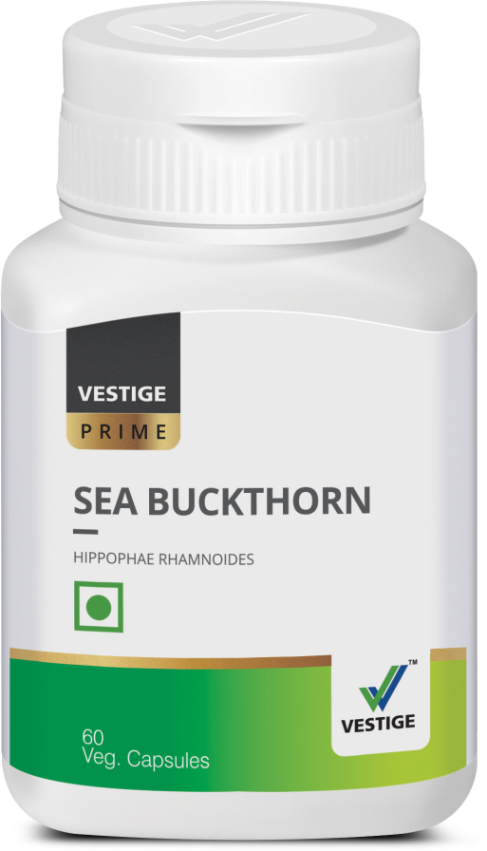
Vestige Prime Sea Buckthorn
Vegetarian Capsule

Slide 10
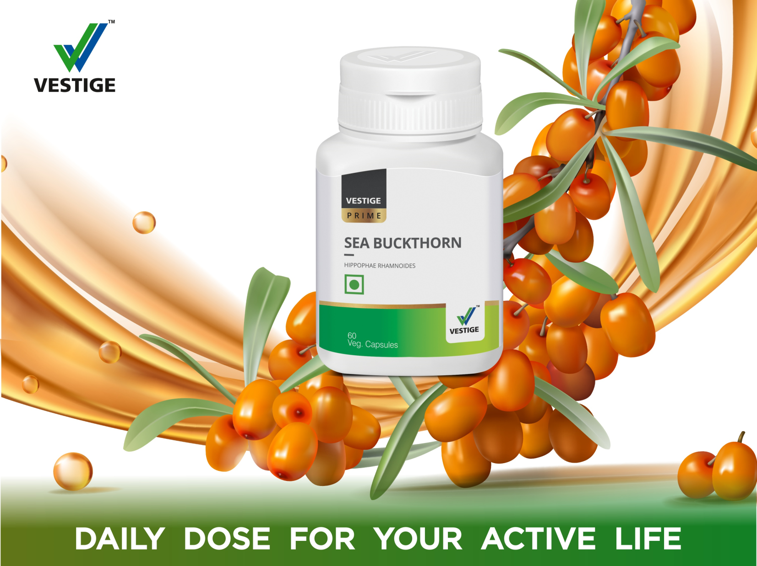

Slide 11

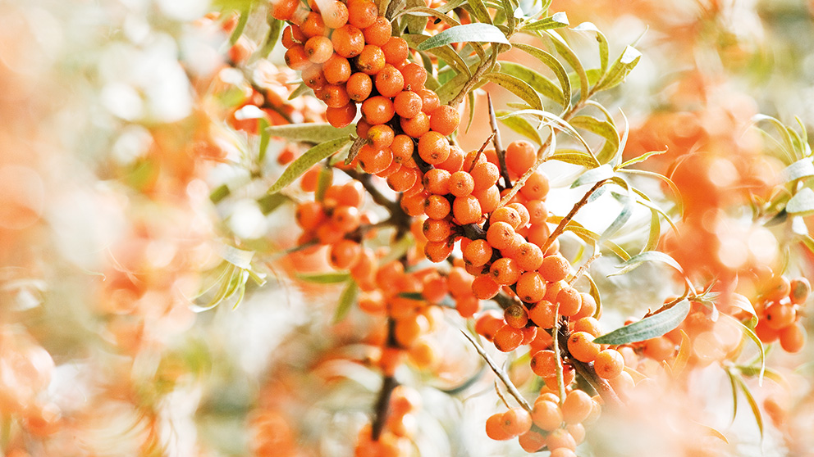
Sea Buckthorn
Sea Buckthorn (Hippophae Rhamnoides) is a berry-filled bush that has long been used in traditional medicine for restoring health.
Sea buckthorn is not a sea fruit/food.

Slide 12
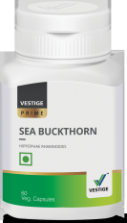
Sea Buckthorn History
Sea buckthorn has been in use since approximately 1400 years for medicine purpose*
Sea buckthorn is also known as “wonder berry” or “Leh berry”**
During the military expedition of Alexander the Great, the warriors ate berries and regained strength
The sea buckthorn is widespread in Asia, Europe and Russia and recently was also found in Canada
It is found in negative altitude temperature zones
Defence Research and Development Organisation (DRDO) picked this berry to make products for Indian Army personnel survive in an active mode at the higher altitudes
Astronauts also consume this fruit as a food in space shuttles to maintain high energy level
*Wikipedia
**www.thebetterindia.com

Slide 13
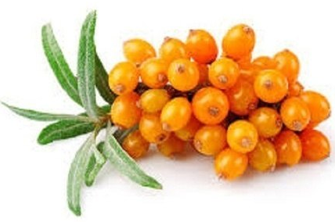
Vestige Prime Sea Buckthorn
Sea Buckthorn has been used since time immemorial for numerous health benefits.

Slide 14
Vestige Prime Sea Buckthorn
Vitamins
Vitamin K, C, A, E, B complex, Vitamin P (flavonoids)
Omega 3,6,7,9 fatty acids
Minerals
Zinc, Iron, Magnesium
Amino Acids
Methionine, leucine. Lysine, glycine

Slide 15
Vestige Prime Sea Buckthorn
Over 190 bioactive compounds in one tiny berry
Carotenoids
Tocopherols
Flavonoids
Lipids
Ascorbic acid

Slide 16
Active ingredients of Sea Buckthorn and their therapeutic effects individually
Component | Therapeutic Effect
Tocopherols | Antioxidant activities
 | Minimisation of lipid oxidation
 | Pain alleviation
Carotenoids | Antioxidant activities
 | Contribution to collagen synthesis
 | Contribution to epithelium growth
Vitamin K | Haemorrhage prevention
 | Wound healing support
 | Positive effect against ulceration
Vitamin C | Antioxidant activities
 | Maintenance of membrane cell integrity
Vitamin B complex | Cellular renewal stimulation
 | Nerve tissue regeneration
Phytosterols | Improvement of micro circulation in the skin
 | Anti carcinogenic effect
 | Prevention of ulceration
Michel et al, 2012

Slide 17
Active ingredients of Sea Buckthorn and their therapeutic effects individually
Component | Therapeutic Effect
Polyphenolic components | Antioxidant activities
 | Cytoprotective effect
 | Cardio protective effect
 | Wound healing support
Polyunsaturated fatty acids (PUFA) | Immunomodulating effect
 | Neuroprotective effect
 | Anti carcinogenic effect
Coumarins & Triterpens | Support for appetite, sleep, memory and learning
Zinc | Blood circulation
 | Enzyme cofactor function
 | Increased utilisation of Vitamin A
Michel et al, 2012

Slide 18
Sea buckthorn Benefits
Maintains high energy
Vitamin C and other nutrients helps to reduce headache, dizziness and increases mental attention
Vitamin E and minerals like Zinc and selenium have high anti-oxidant properties
Wonderful Antioxidants to protect brain tissues from damaging effect of free radicals and toxins
Stamina building:
Vitamins help to reduce common symptoms like fatigue such as low energy and muscle tension and help in getting a sound sleep.
Cardiac benefits
Flavonoids may help to regulate blood pressure, improve heart function and reduce stress on heart tissue
Flavonoids may help to regulate thyroid function and thus relieve hyperthryroidism or hypothyroidism
May Helps build, restore and improve immune function

Slide 19
Sea Buckthorn Benefits
Diabetic benefits
Sea Buckthorn in diabetics may help to reduce LPO (Lipid Peroxidation) by decreasing free radical formation and helps in lowering the blood glucose level
Omega 7 fatty acids in Sea Buckthorn are considered helpful fatty acids, which signal the body for stopping fat storage
It may help improve insulin secretion and insulin sensitivity, both of which could protect against type 2 diabetes.
Skin benefits
Vitamin A, Vitamin E and Omega 7 fatty acids are considered essential nutrients for skin and they promote tissue and collagen regeneration, reduce skin wrinkles and premature skin ageing
Gastric benefits
Sea Buckthorn is believed to normalise gastric acid production. It protects mucus membrane from irritation of gastric juices and are helpful reliving symptoms of GERG including heartburn.
Sea Buckthorn is good for liver and prevents its damage from toxic chemicals
It helps to provide relief to dry eyes

Slide 20
Richest plant source in the world for Omega 7 fatty acids
Also known as palmitoleic acid
Omega 7 fatty acids are found only in two plant sources: macadamia nut oil, and Sea Buckthorn oil
One of the newest “good fats” known, and is being studied for metabolic benefits and skin care benefits (nourishment and wrinkle prevention)

Slide 21

USPs of Sea Buckthorn
Enhances mood
Maintains high energy level
Improves gut health
Proper concentration
Good sleep
Controlled weight
Reduces Stress
Good appetite

Slide 22

Vegetarian capsules

Slide 23
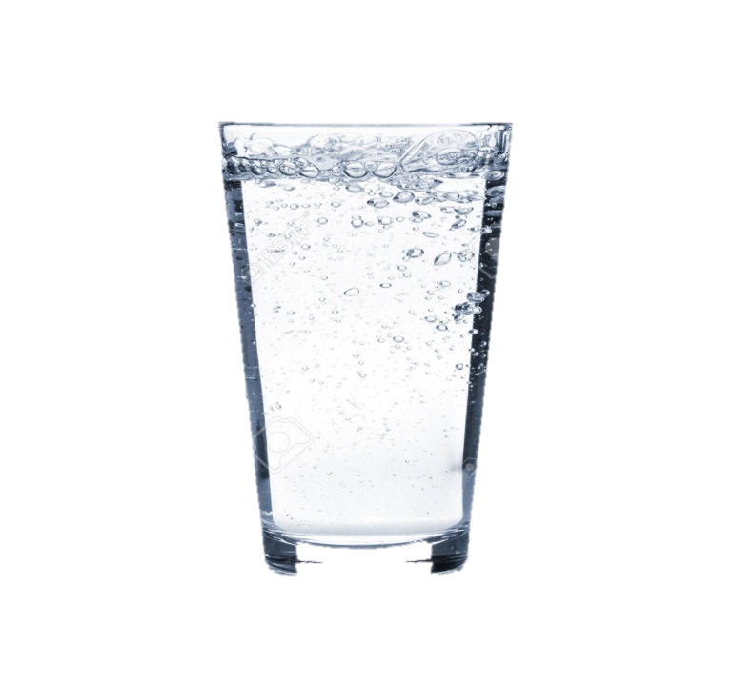

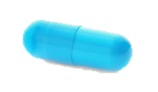
Sea Buckthorn Capsules –Recommended dosage
One capsule twice a day after meals

Slide 24
Vestige Sea Buckthorn Capsules
MRP
Rs 1,000/-
PV
28.33
DP
Rs 850/-

Slide 25
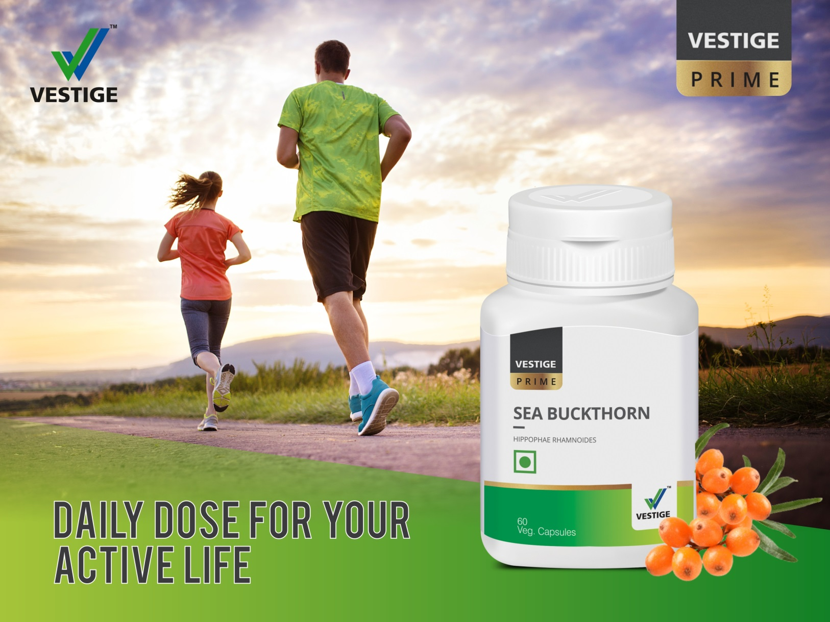

Slide 26
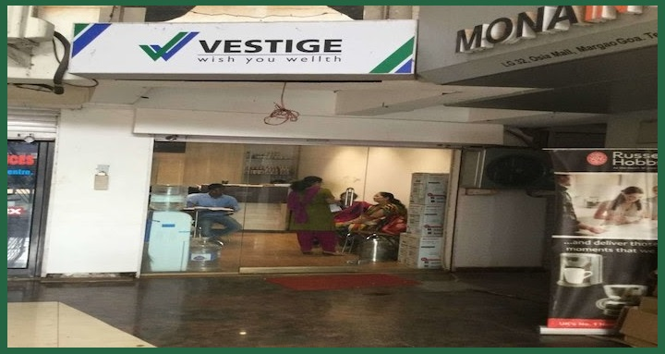
Visit your nearest Vestige branch, DLCP and grab your packet of Vestige Prime Sea Buckthorn capsules today

